Slide 1
Setup Guide
Steps to install PictoBlox and create a new project

Slide 2
Install PictoBlox
Click on this link: https://thestempedia.com/product/pictoblox/download-pictoblox/
If not, or copy and paste it in the browser

Slide 3
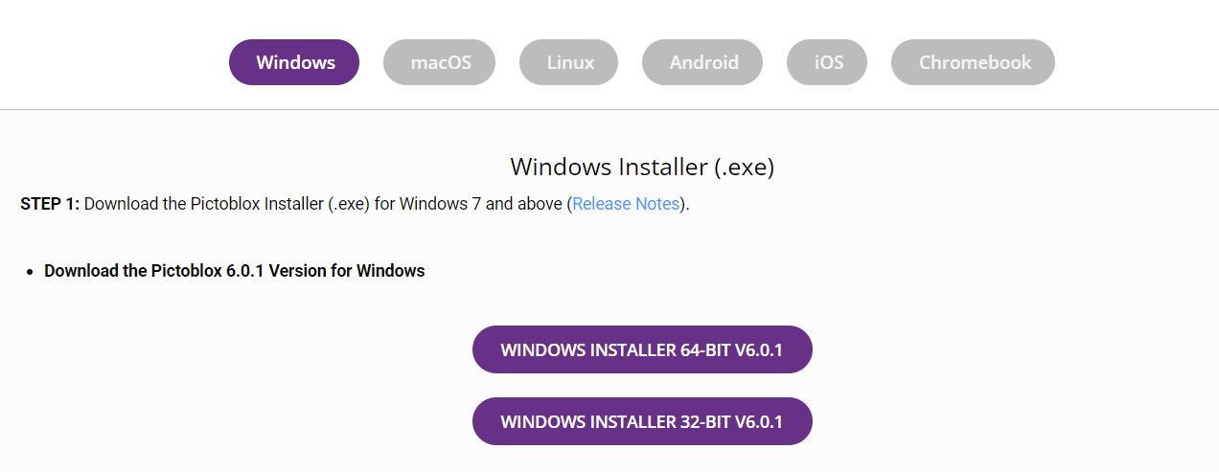
Install PictoBlox
Select the suitable version
Note that most newer Windows computers support 64-bit

Slide 4
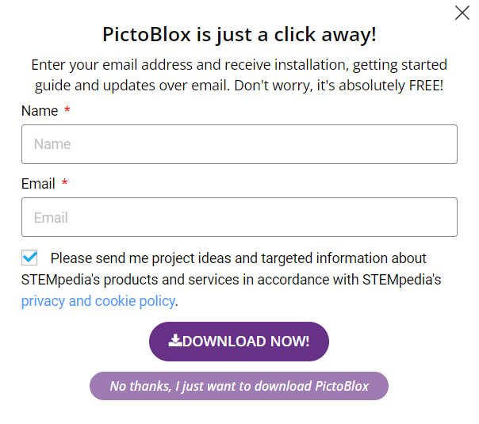
Install PictoBlox
A pop up will appear
Click on “No thanks, I just want to download PictoBlox”

Slide 5
Install PictoBlox
A pop up will appear
Click on “No thanks, I just want to download PictoBlox”
The rest of the steps should be simple enough that I will skip them

Slide 6
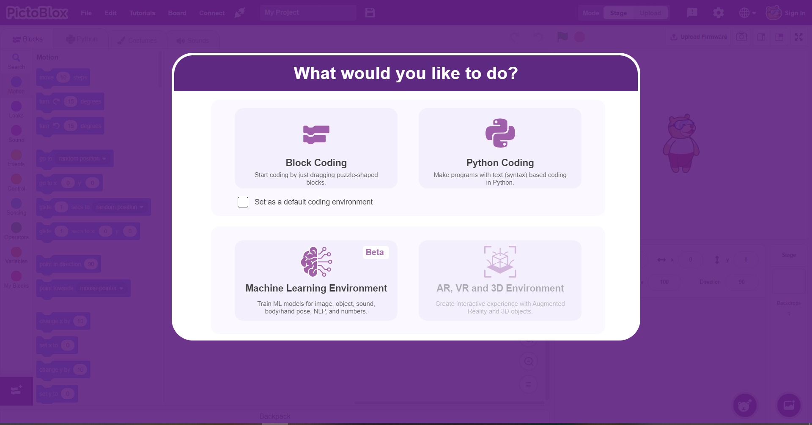
Creating a new project
Click on “Block Coding”
You can check “Set as a default coding environment” as well

Slide 7
Signing in
An PictoBlox account is needed for some features in the later lessons
Make sure you have an e-mail, preferably one that is not your main account
This guide will assume that you don’t have an account

Slide 8
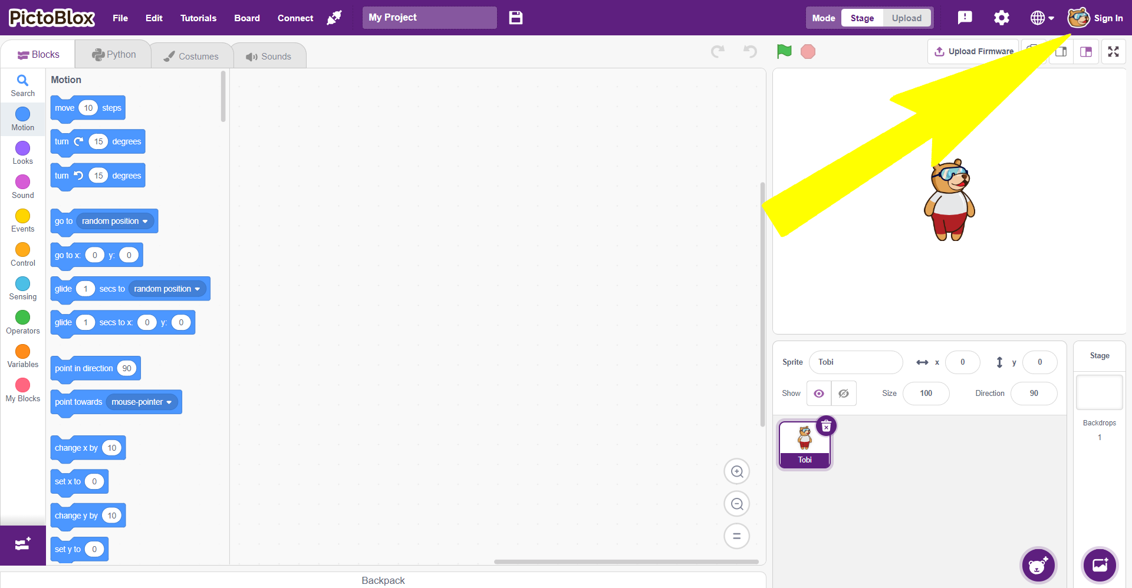
Click on Sign In

Slide 9
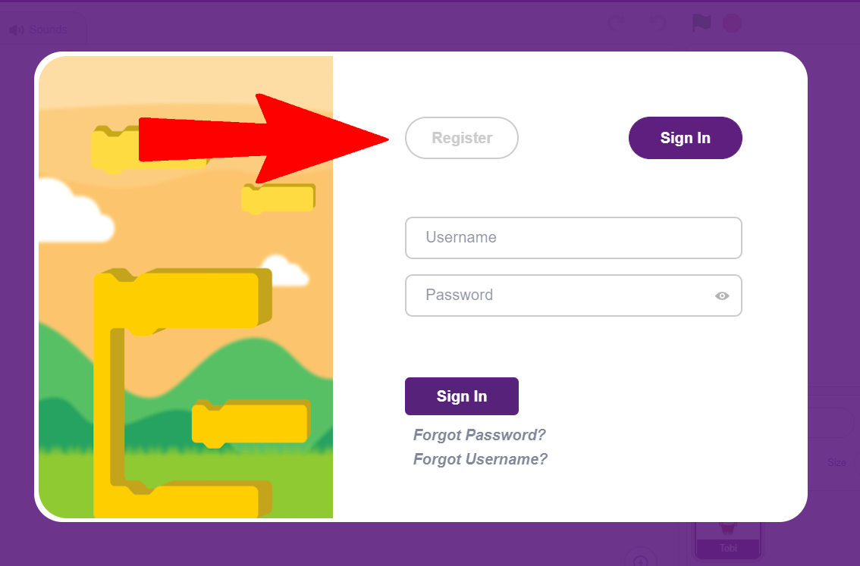
Click on Register

Slide 10
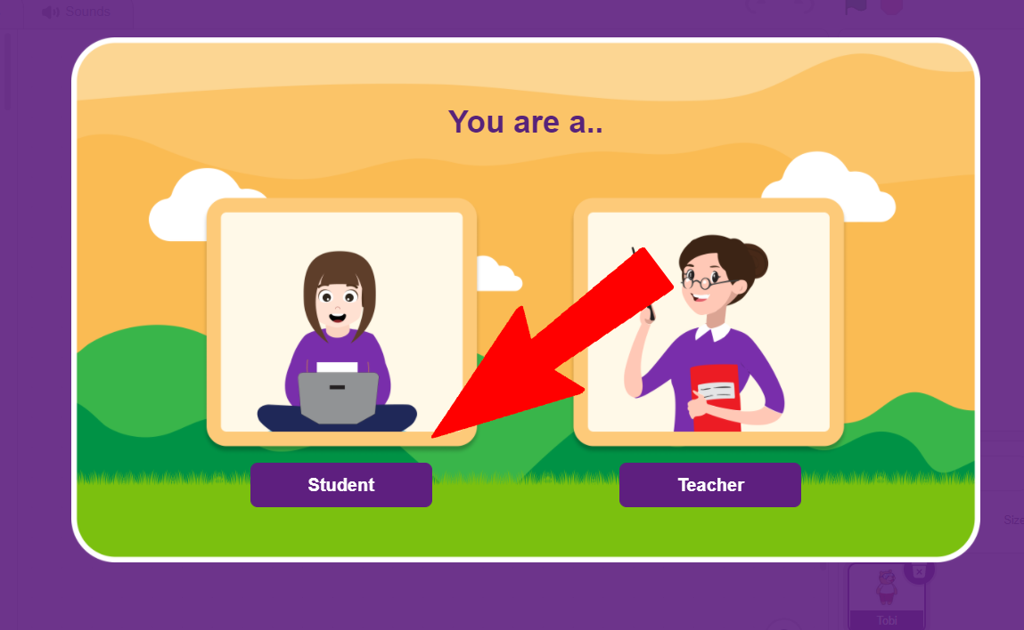
Click on Student

Slide 11
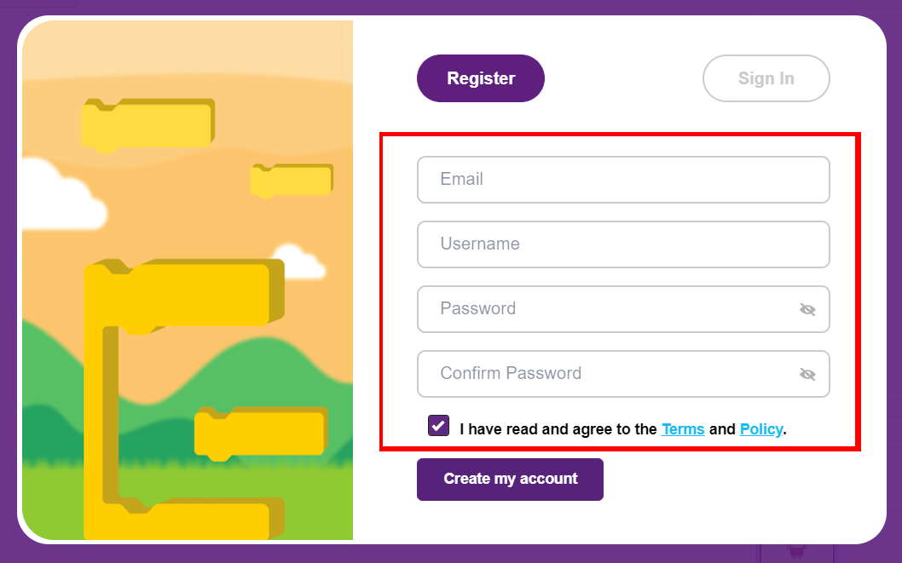
Fill in the required info

Slide 12
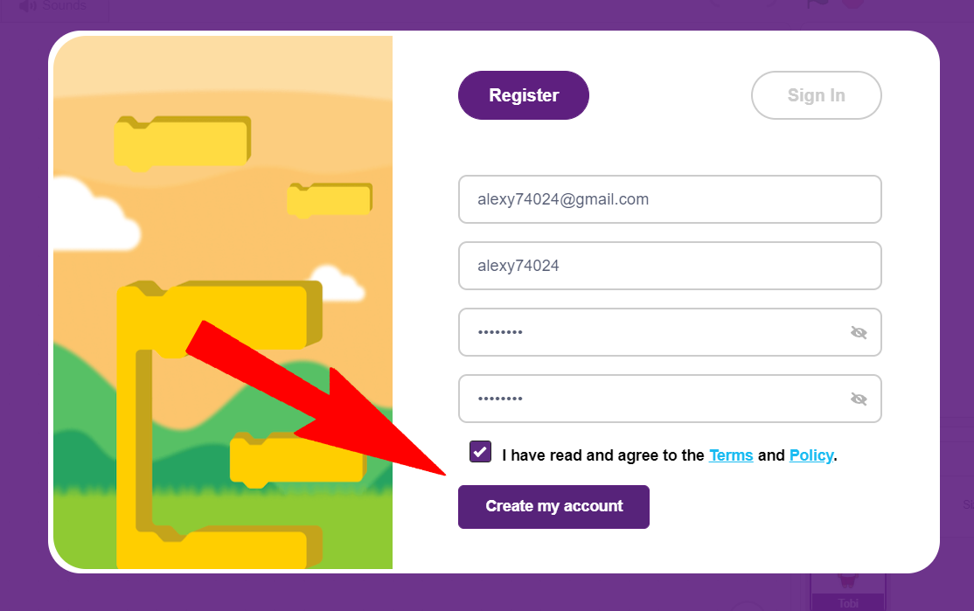
Click on “Create my account”

